Slide 1
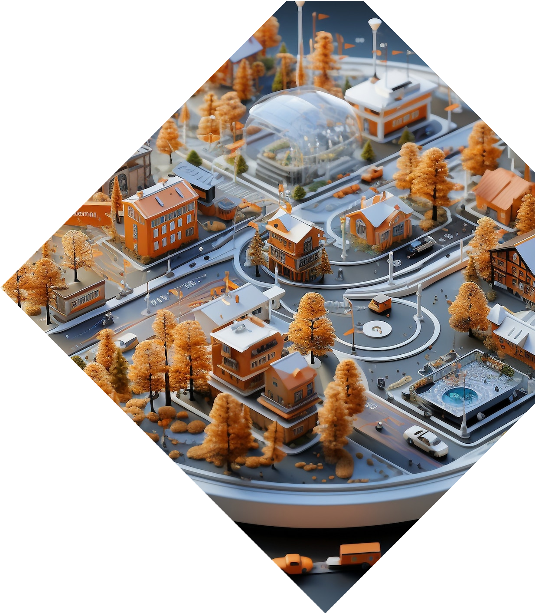

Project Title: Smart Waste
Management System using ESP32

Slide 2
Introduction to Smart Waste Management

Slide 3

Project Objectives
Automate waste detection and
disposal.
Reduce human intervention in waste collection.
Enhance waste management efficiency using IoT. Alert system for waste overflow.

Slide 4

Components Used
ESP32 Microcontroller (Main processing unit)
IR Sensor (Detects waste presence)
Ultrasonic Sensor (Measures waste
level)
Servo Motor (Opens/closes the dustbin
lid)
Buzzer (Alerts when the bin is full) LED (Indicates system status)

Slide 5
Connections
Pin connections:
IR Sensor: VCC -> 3.3V, GND -> GND, Signal -> GPIO
Ultrasonic Sensor: VCC -> 5V, GND -> GND, Trigger
-> GPIO, Echo -> GPIO
Servo Motor: Brown -> GND, Red -> VCC (5V), Yellow -> PWM GPIO
Buzzer: +ve -> GPIO, -ve -> GNDLED: +ve -> GPIO, - ve -> GND

Slide 6
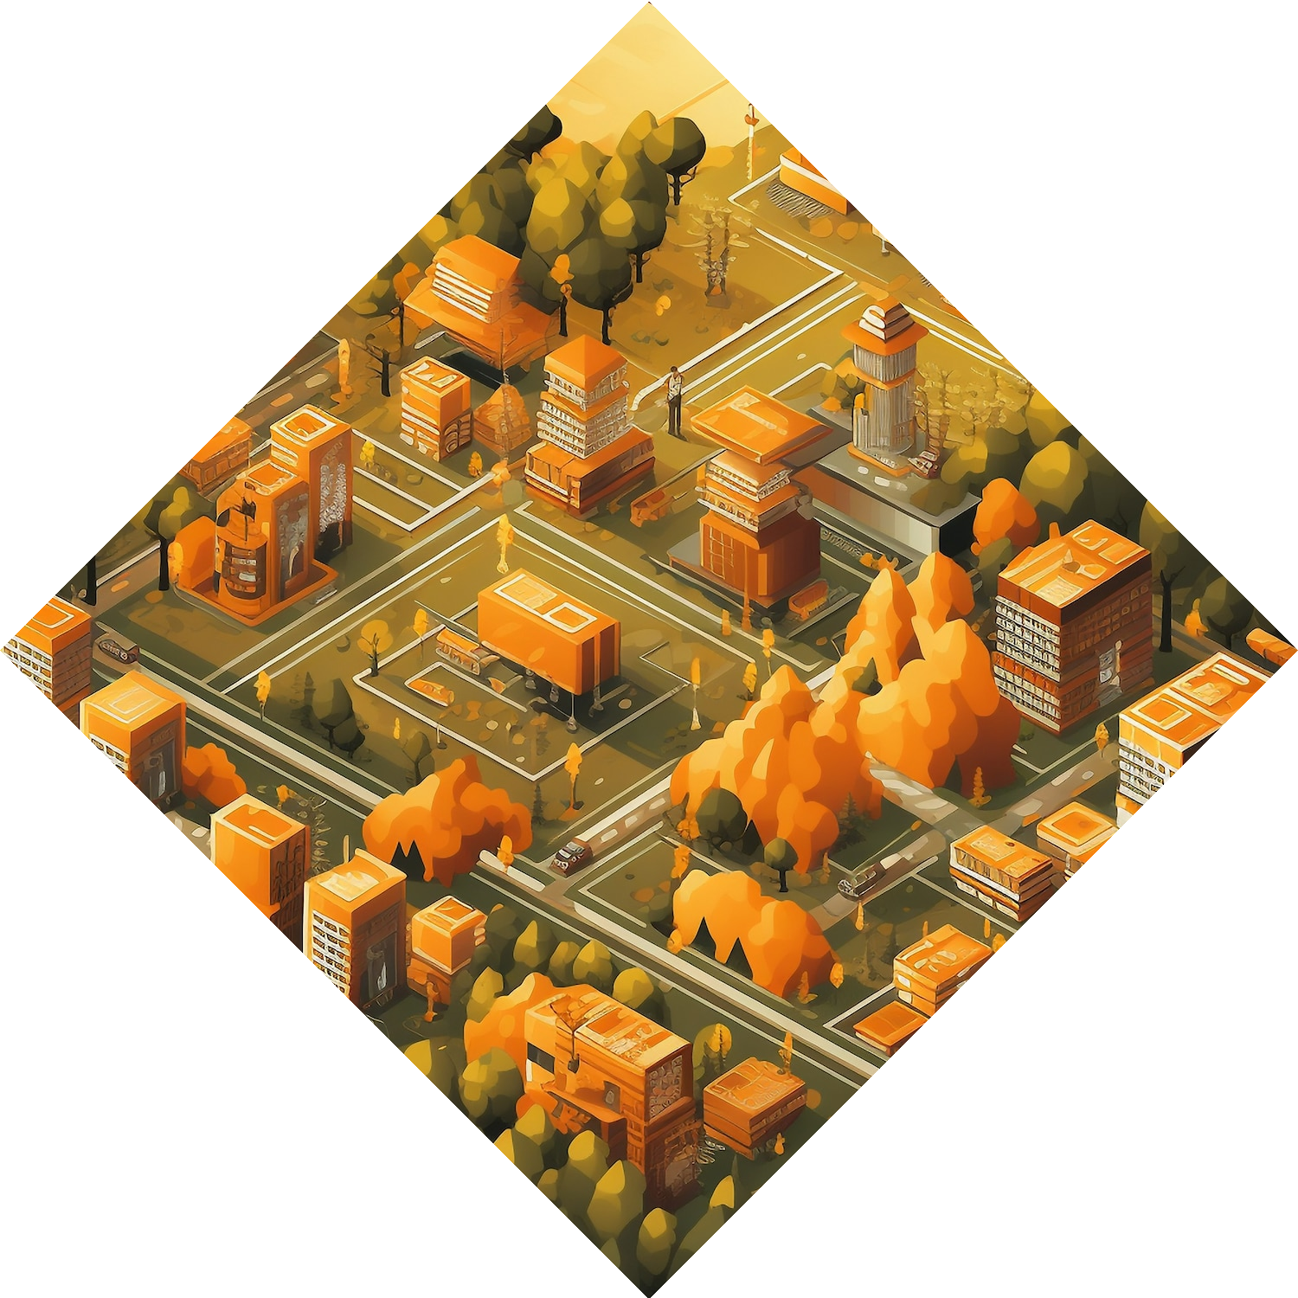
Code Explanation (Main Logic)
Initializing ESP32 pins.
Reading sensor values for waste detection.
Controlling the servo motor for automatic lid
opening.
Activating buzzer and LED when the bin is full.

Slide 7
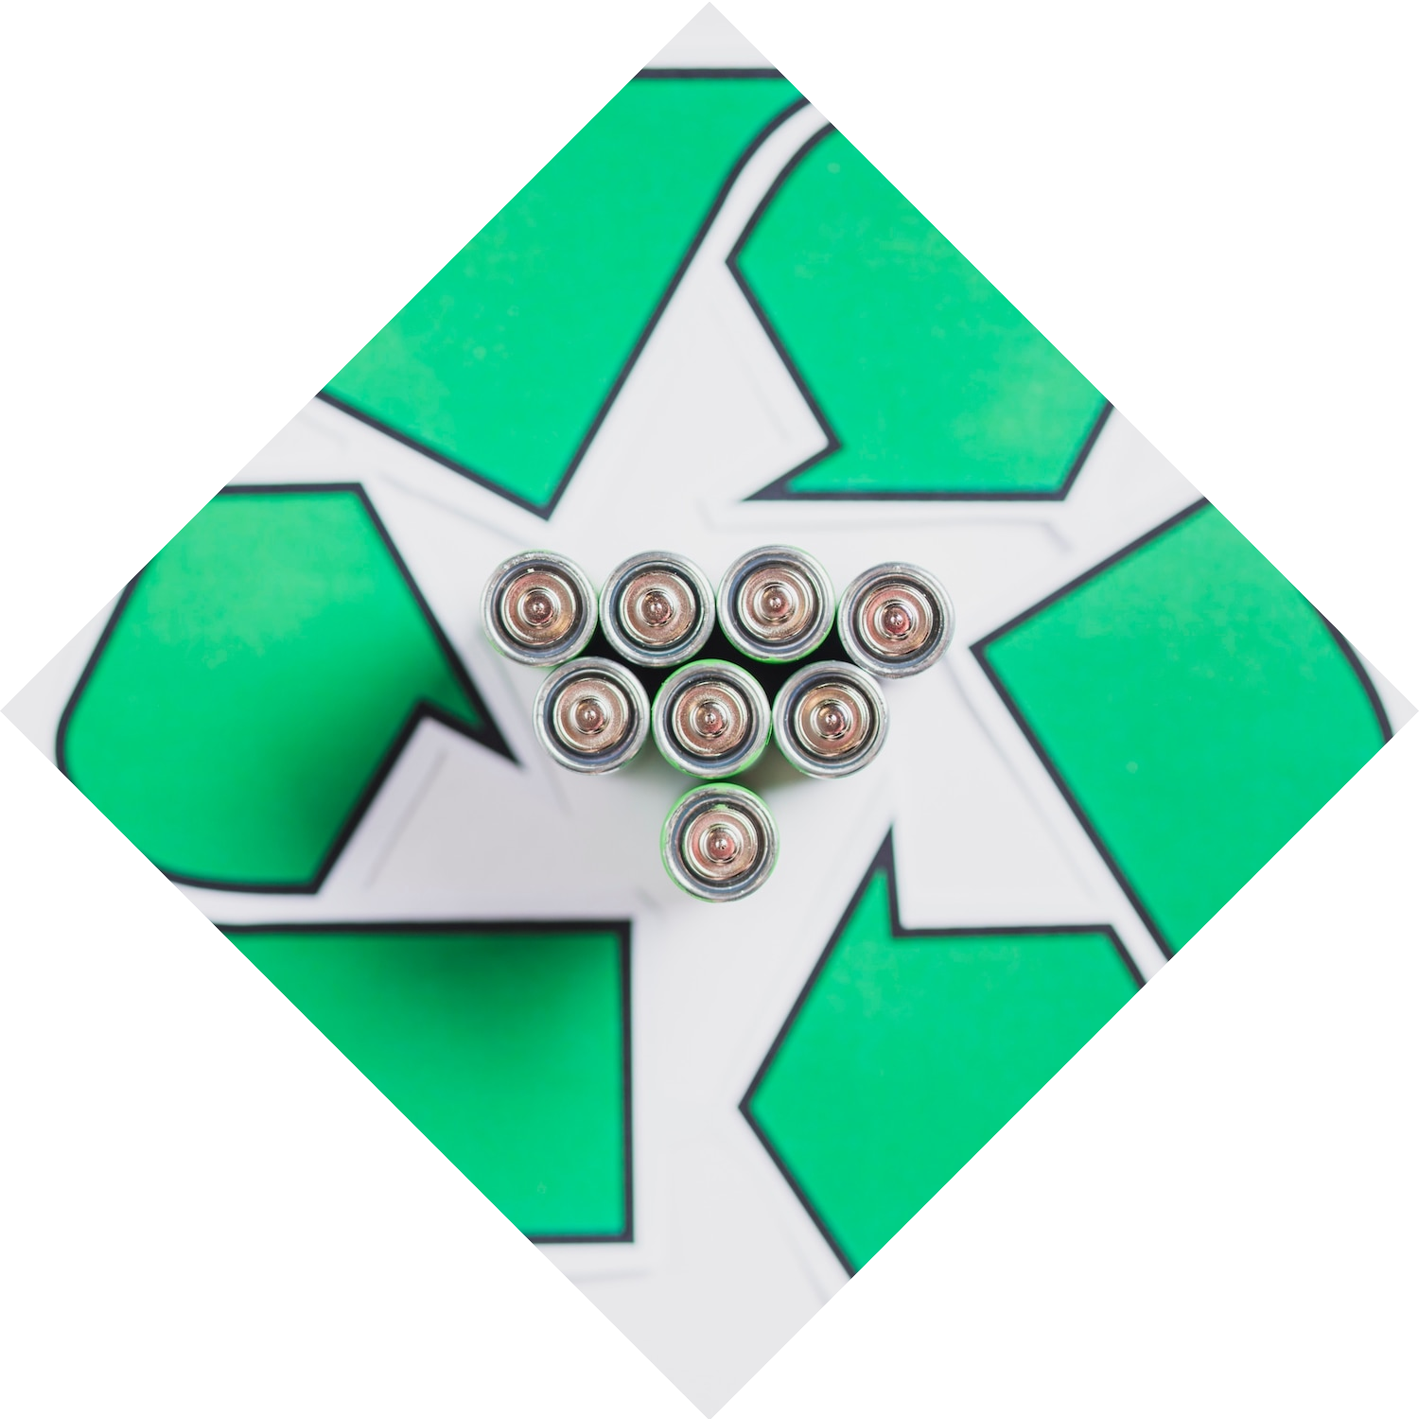
Working Principle
The IR sensor detects waste approaching the bin.
The servo motor opens the lid for
disposal.
The ultrasonic sensor measures the waste level.
If the bin is full, the buzzer and
LED alert the user.

Slide 8
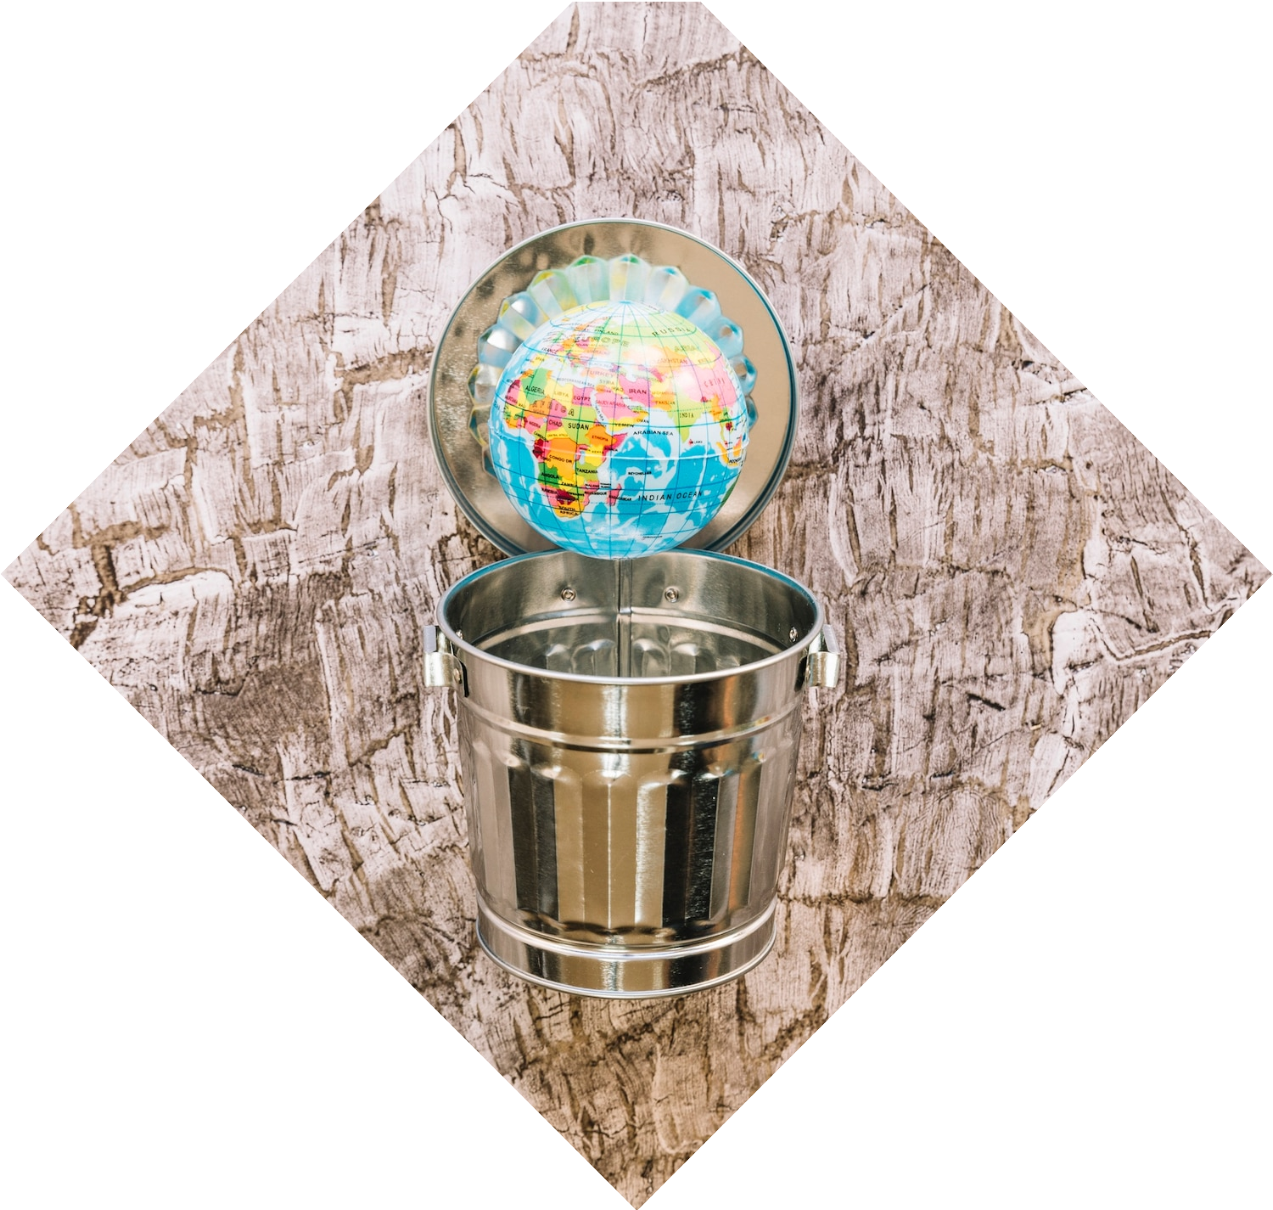
Data Collection and Analysis
Data collected from sensors is analyzed to provide insights into waste generation patterns. This information helps in optimizing collection schedules and routes, reducing costs, and minimizing environmental impact. Effective data analysis is crucial for sustainability.

Slide 9




Benefits of Smart Waste Management
Implementing an IoT-driven waste management system offers numerous benefits, including ,
, and
.
These advantages contribute to a cleaner and more sustainable urban environment, enhancing residents' quality of life.

Slide 10

Expected Results
Automatic bin lid operation.
Alerts for waste overflow.
Real-time monitoring using ESP32.

Slide 11
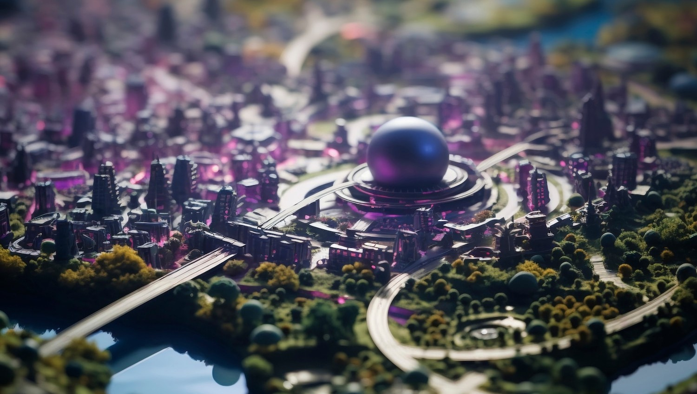
Case Studies and Success Stories
Several cities have successfully implemented IoT-driven waste management systems, showcasing significant improvements in efficiency and sustainability.
These case studies provide valuable insights and best practices for future implementations in
urban areas.

Slide 12




Future of Urban Waste
Management
The future of urban waste management lies in the continued integration of
and
. As cities evolve, adopting innovative solutions will be essential for achieving long-term sustainability goals and enhancing urban living.

Slide 13
Conclusion
Enhances efficiency in waste management. Reduces manual effort in waste collection. Can be further improved using cloud-based monitoring.

Slide 14
Thanks!
Do you have any questions?
rahman.abdul@student.mmu.edu.my
+601121363095

